Slide 1


Project Report: MLP Classification
2018.04.07
Tran Dinh Son

Slide 2
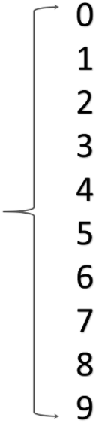

Problem Definition
?
MNIST dataset: 60,000 data (training set) and 10,000 data (testing set)
Applications: Human-machine interaction, surveillance, etc.

Slide 3
Proposed Method
Multilayer perceptron (MLP)
Decision Tree

Slide 4

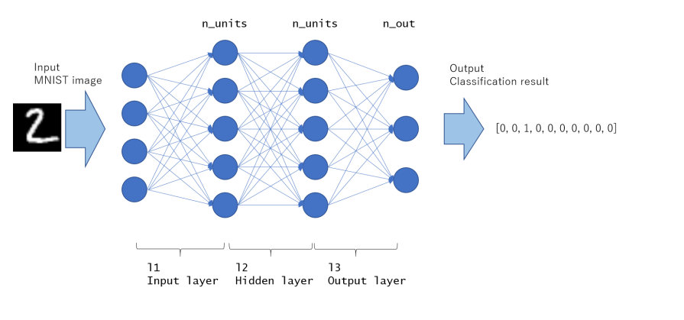
MLP
MLP Classification

Slide 5
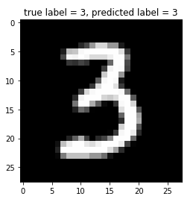
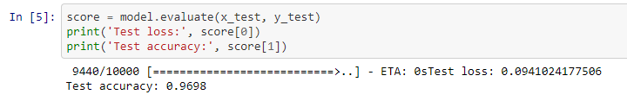
Results on MLP
Training time
Training time with GTX 1080Ti is about 1.2873 minutes for 30 epochs
Training time with GTX 1080 is about 1.4402 minutes for 30 epochs
Evaluate trained model
Test accuracy: 96.98%
Predict test image with trained model

Slide 6
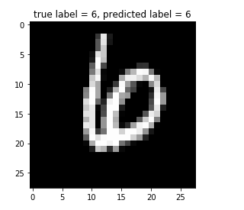
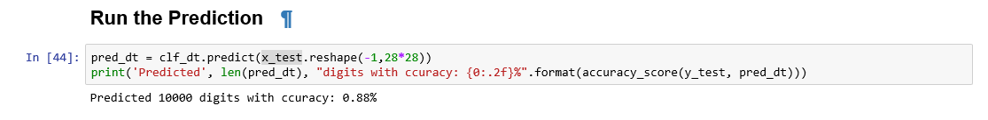
Results on Decision Tree
Training time
Training time with GTX 1080Ti is about 32.76 seconds
Evaluate trained model
Test accuracy: 88%
Predict test image with trained model

Slide 7
Comparison
Methods | Accuracy
MLP | 96.98%
Decision Tree | 88%
The materials for this section is on
https://github.com/trandinhson3086/Data-Mining-class

Slide 8
THANK YOU!

